Slide 1
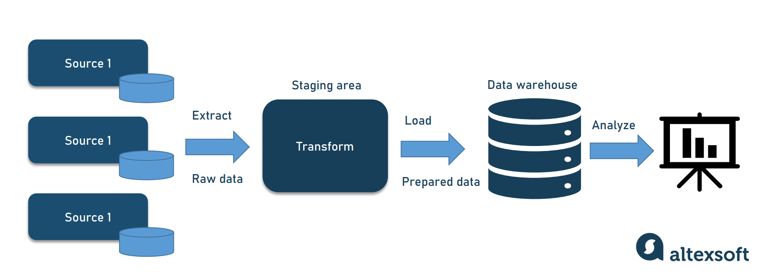
Cloud Analytics and Data Warehouse Implementation
U.S Accident Data (2016 - 2021)
Group 6
Notes:
Mohana

Slide 2
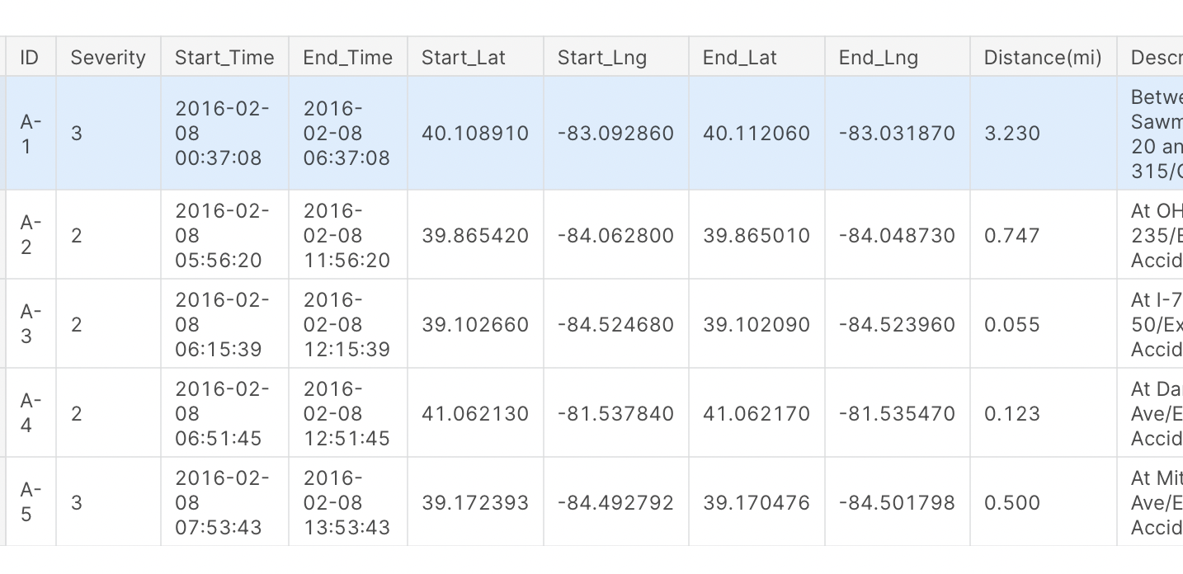
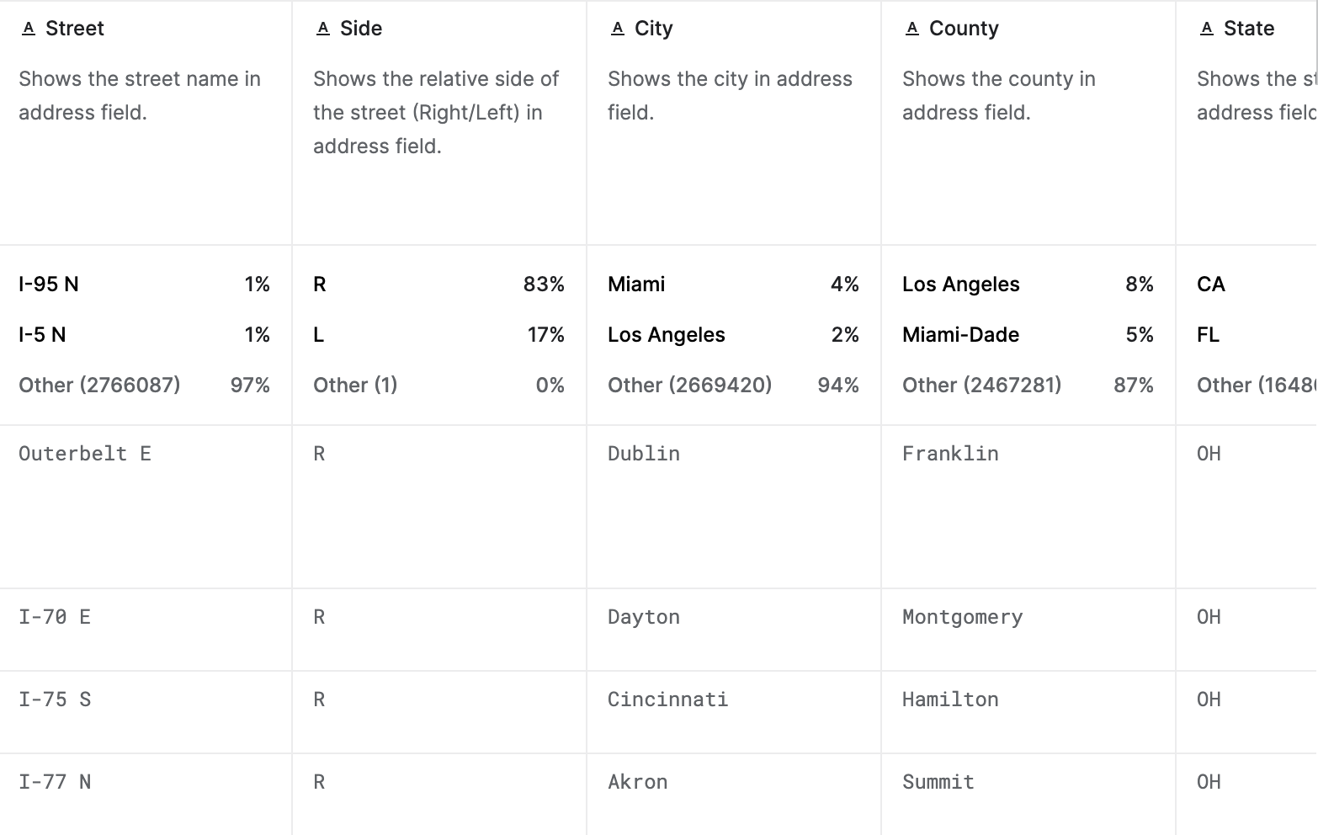
Historical Dataset Introduction
A countrywide accident dataset from Feb. 2016 to Dec. 2021
2,845,342 Rows with 47 Columns
Columns include Severity, Time, Position, Distance, Location, and Weather Conditions etc..
Analyze the reason of increasing number of car accidents (According to NHTSA 10% increase of accidents from 2020) 38k -> 42k
Investigate solutions to decrease or avoid car accidents
Notes:
Quan

Slide 3
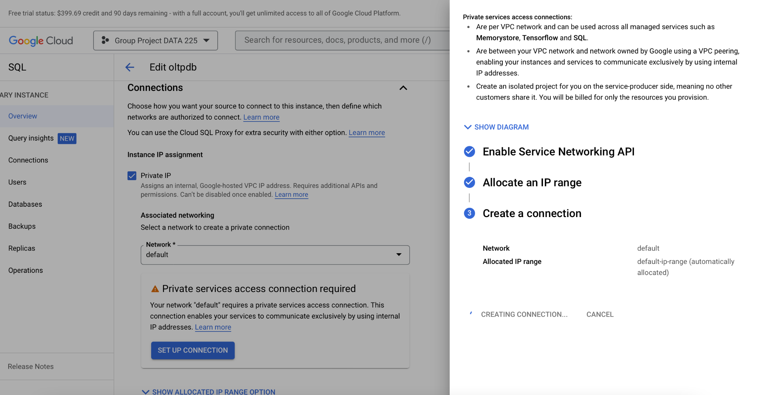
Cloud SQL and VPC
Configure a Cloud SQL instance to use private IP, connect between your VPC network and Cloud SQL
Makes it easy to set up, maintain, manage and administer your relational databases on GCP.
Automated and on demand backups, and point in time recovery
Notes:
Nail

Slide 4
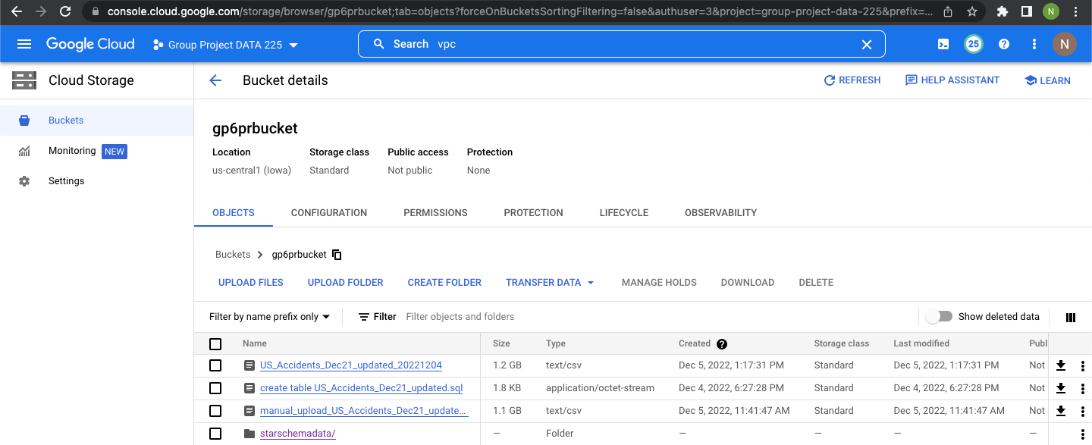
Google Cloud Bucket (extracted dataset and star schema tables)

Slide 5
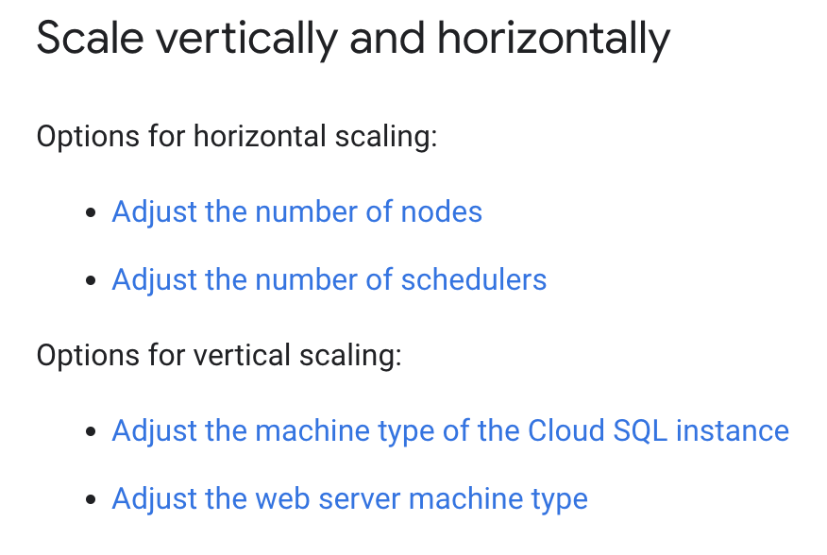
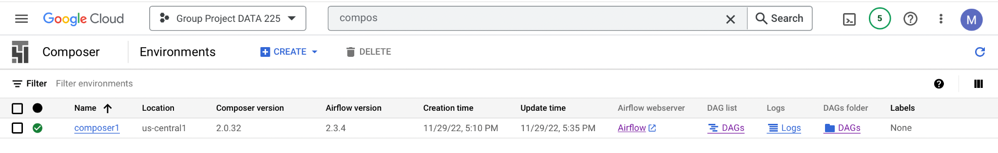
Google Composer
The Cloud Composer is a managed workflow orchestration service
Hosted on a container-based cluster enabling auto-scaling both horizontally and vertically.
Enabling you to create, schedule, monitor, and manage workflows that span across clouds and on-premises data centers, such as GCP.
Cloud Composer is built on the popular Apache Airflow open source project and operates using the Python programming language.
Notes:
Nail

Slide 6

Airflow Pipeline
Apache Airflow: It manages, structures, and organizes ETL pipelines using Directed Acyclic Graphs (DAGs).
DAG stands for Directed Acyclic Graph. DAG is a collection of tasks organized in such a way that their relationships and dependencies are reflected.
Allows the workflow to be designed and scheduled, ETL (Extract, Transform and Load) scripts are developed in Python and orchestrated using a Cloud Composer.

Slide 7
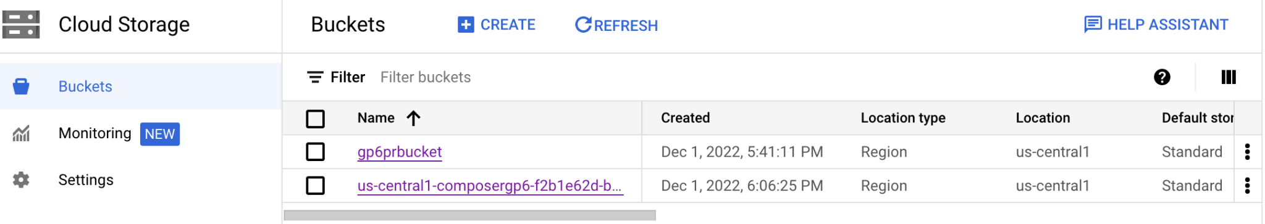
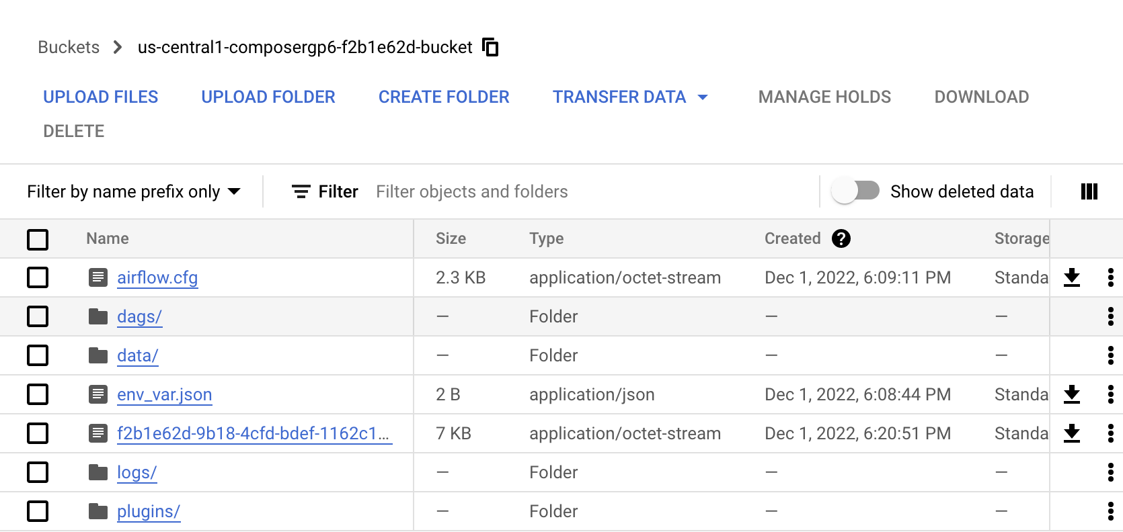
Google Composer Bucket (DAGs)
Notes:
Nail

Slide 8
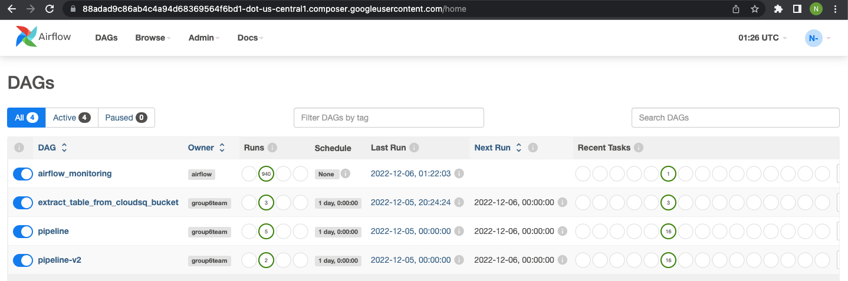

Slide 9
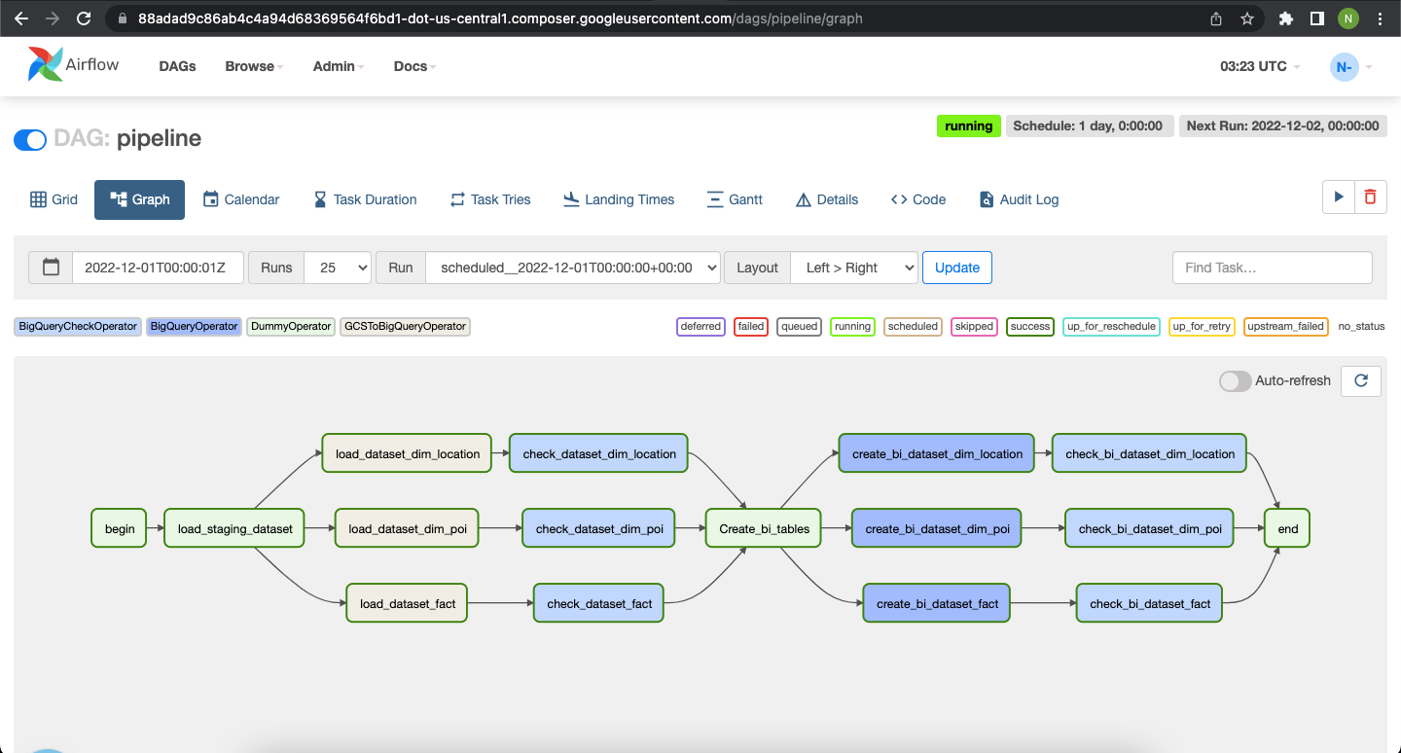

Slide 10
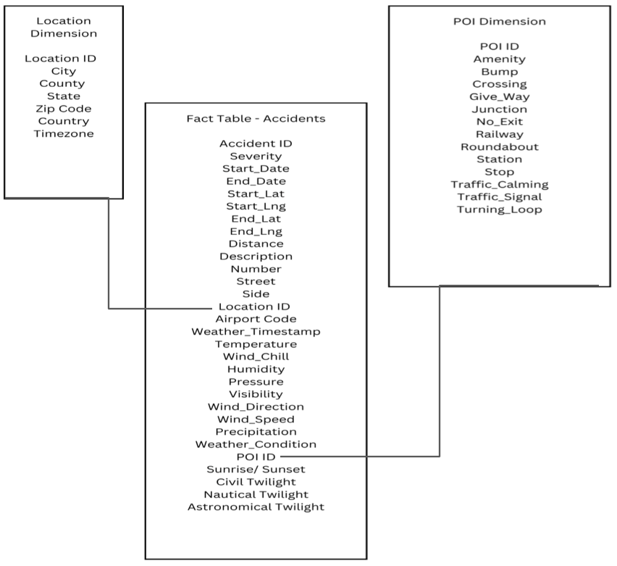
Star Schema Diagram
Star Schema is used for the data model when storing data in the warehouse as it is very commonly used in OLAP
Stores data in the form of fact and dimension tables.
Facts hold numeric values that represent a specific event which are the traffic accidents in this case.
Dimensions contain values which describe these facts and attributes that are used to search, filter and classify facts.
Notes:
Nasim

Slide 11
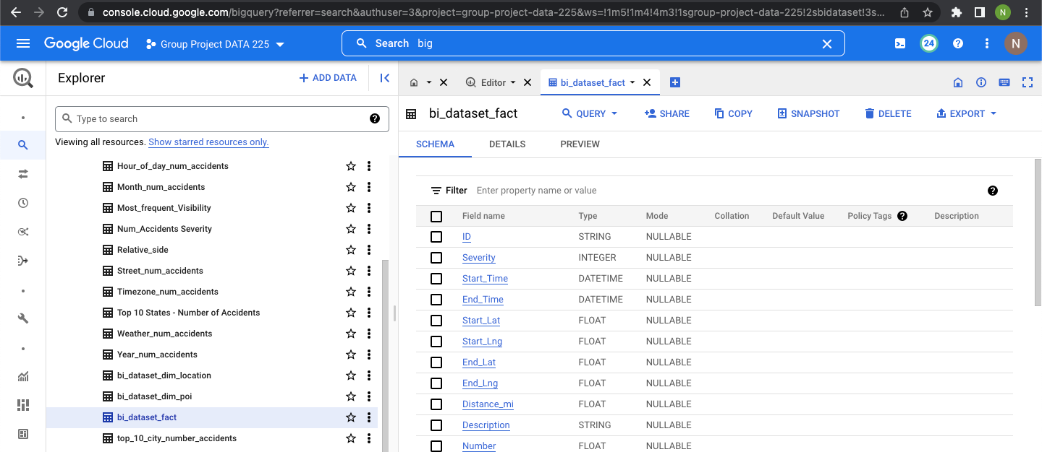
BigQuery datasets

Slide 12
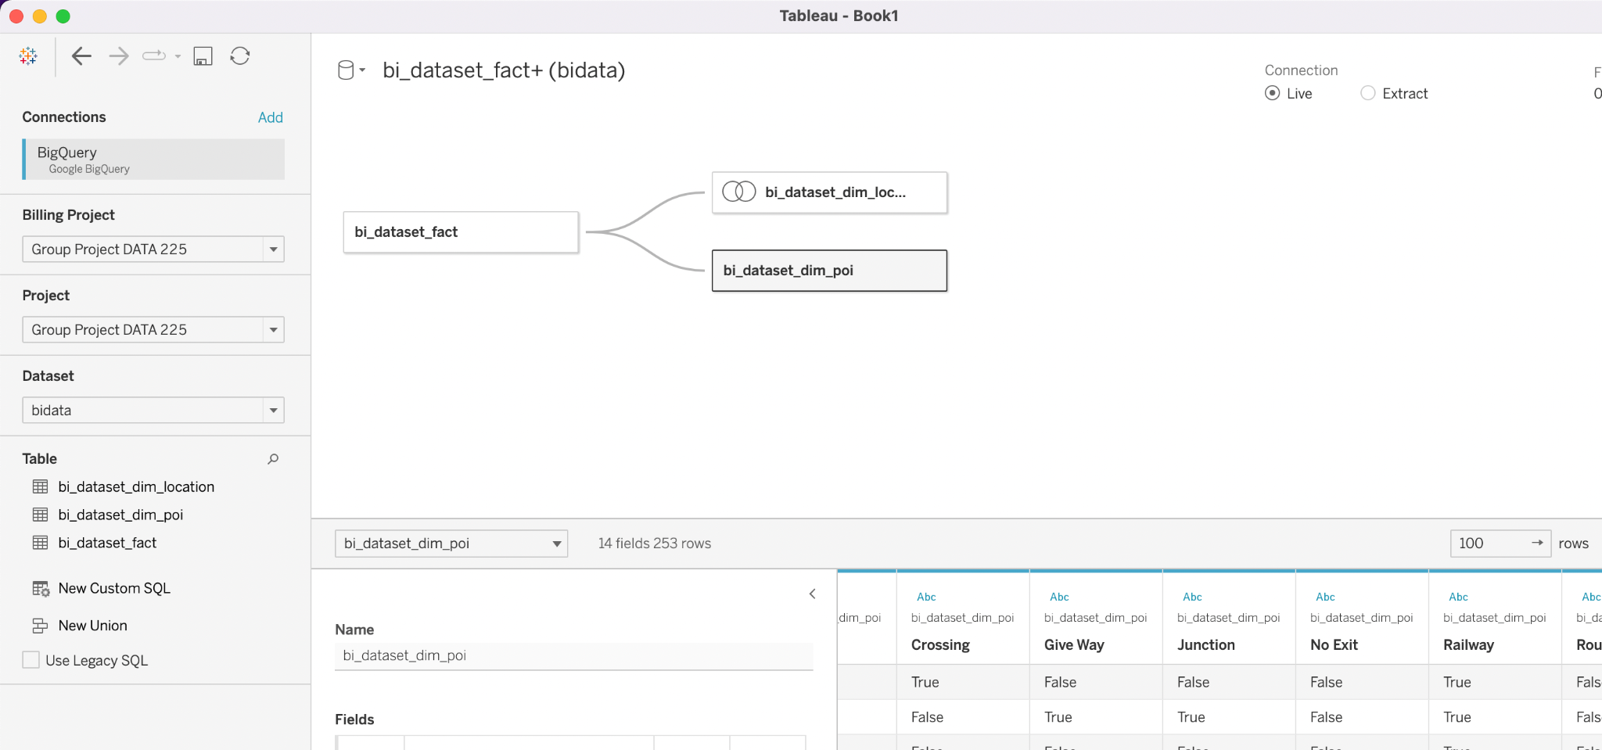
Business Intelligence
Done using Tableau, a business intelligence software that allows anyone to connect to their respective data, visualizes that data and creates interactive, shareable dashboards.
Connected Google Big Query instance to Tableau Desktop
Created a relationship on fact table with the location dimension table
Notes:
Mohana - Tableau:

Slide 13
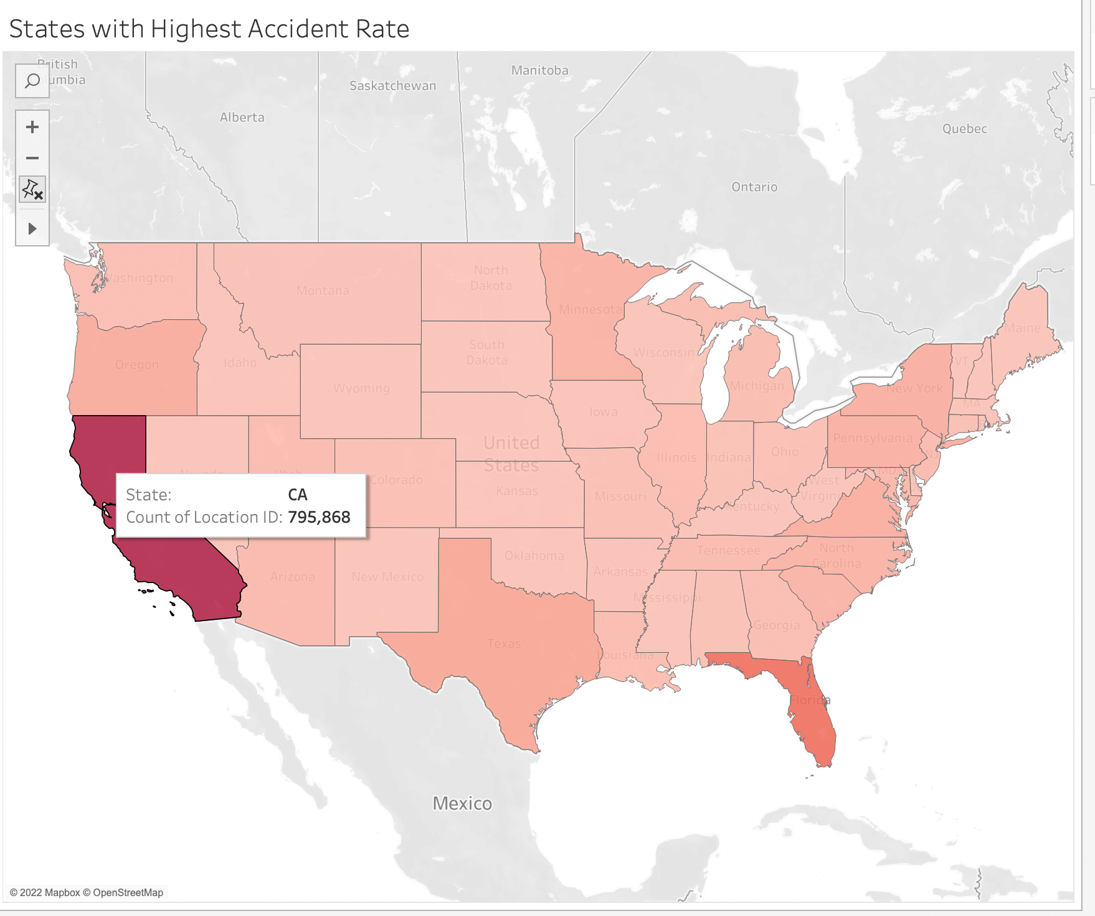
Notes:
Mohana

Slide 14
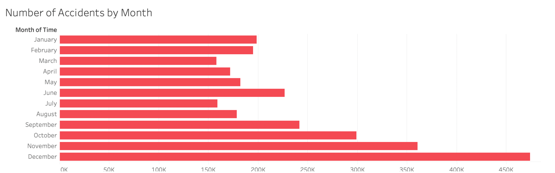

Slide 15
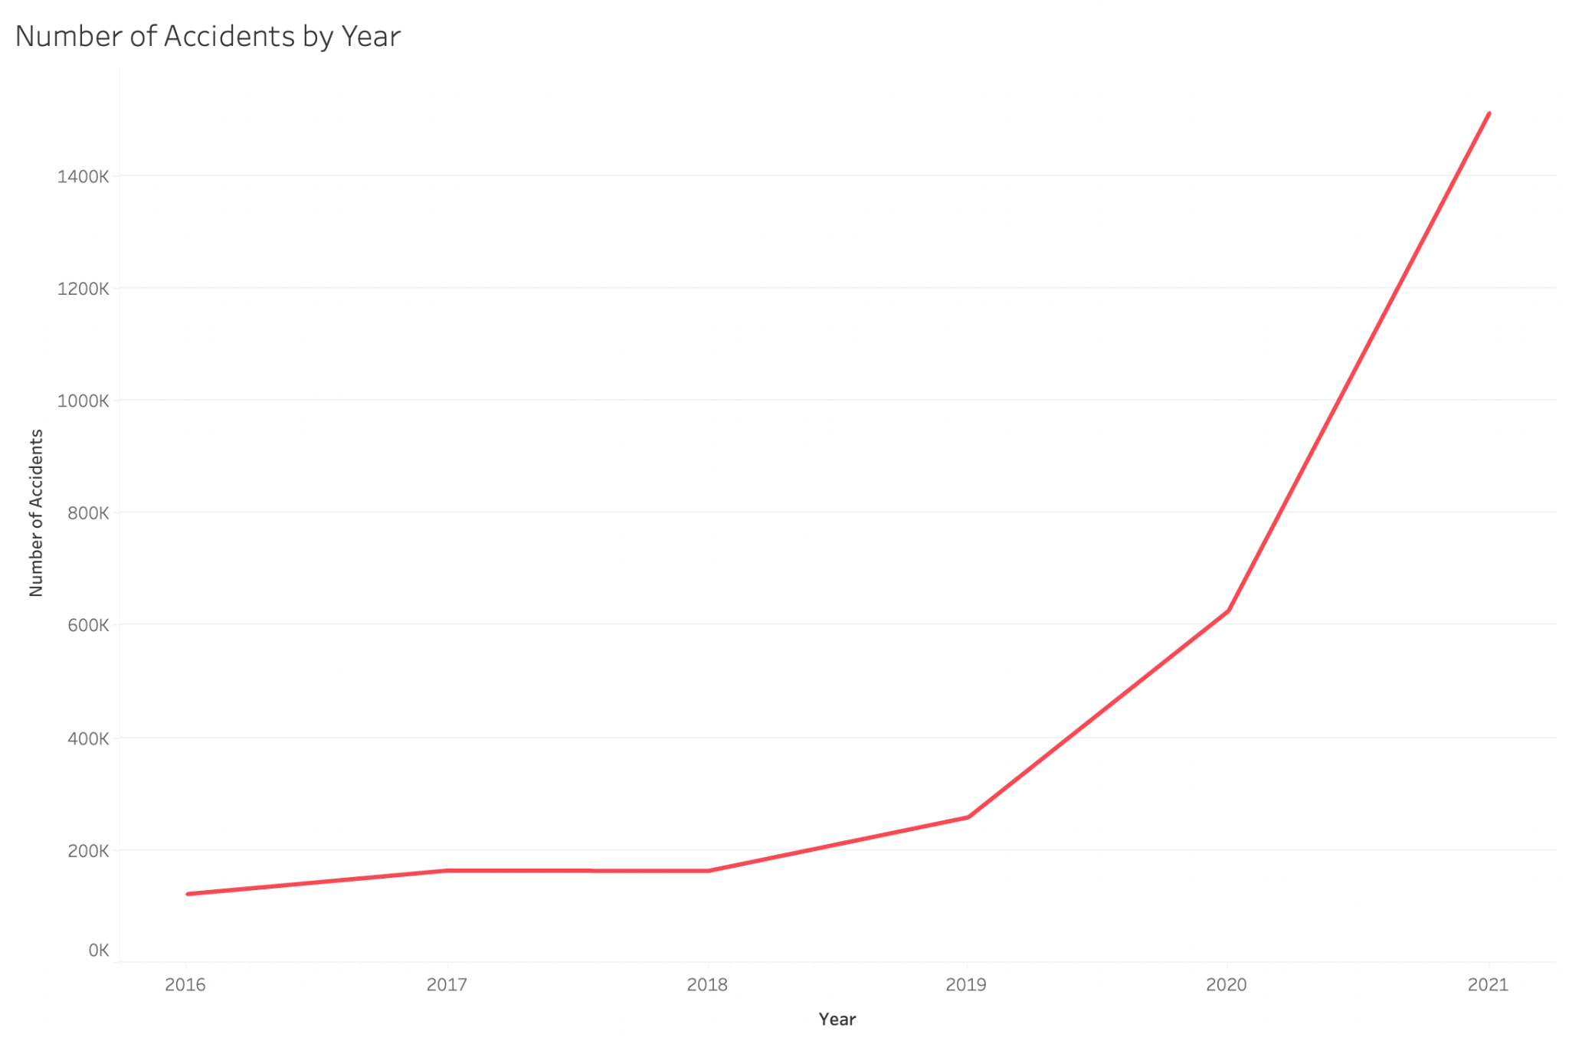

Slide 16
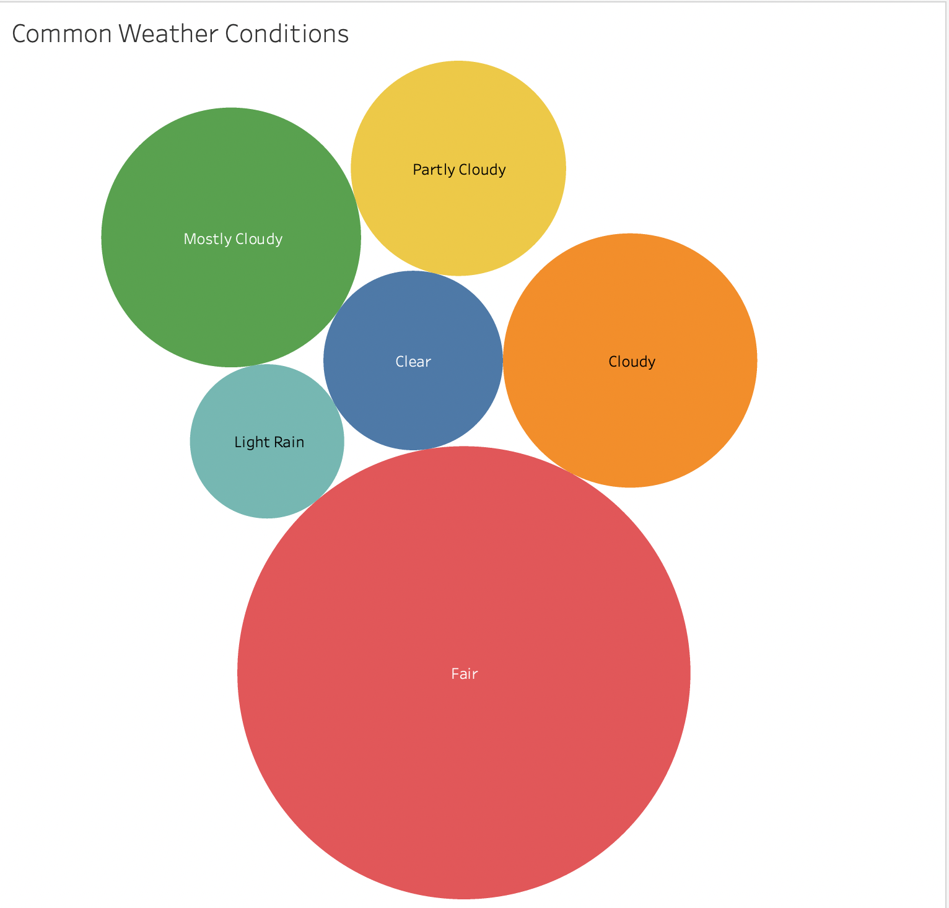

Slide 17
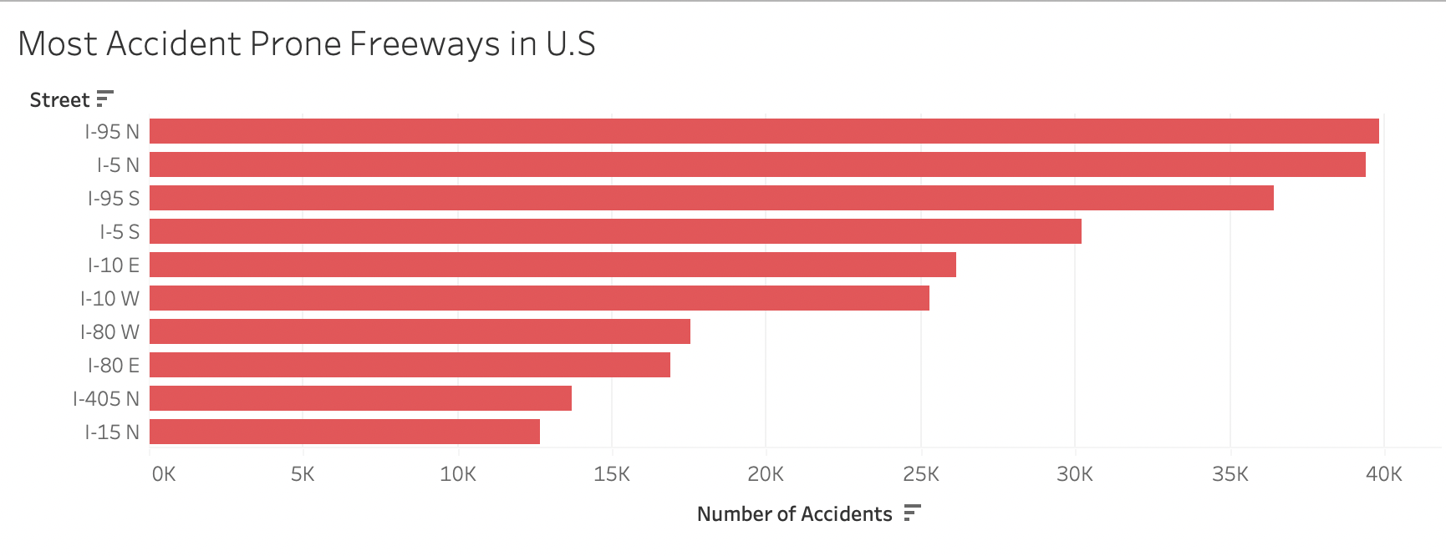

Slide 18

Data Analytics with Queries

Slide 19
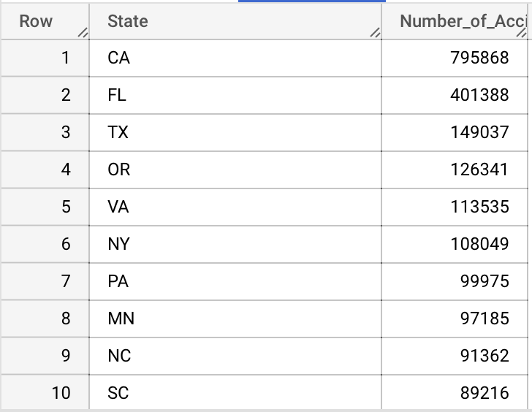
Query: Top 10 States with the Most Accidents

Slide 20
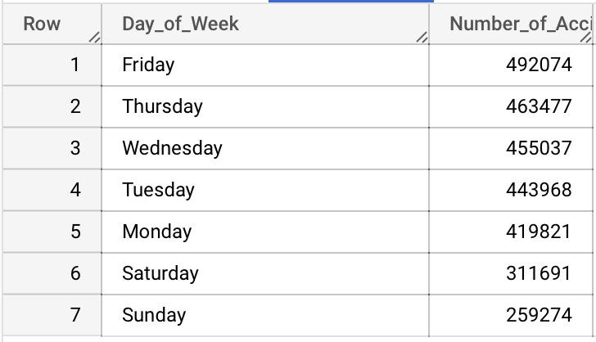
Query: Number of Accidents Per Day of Week

Slide 21
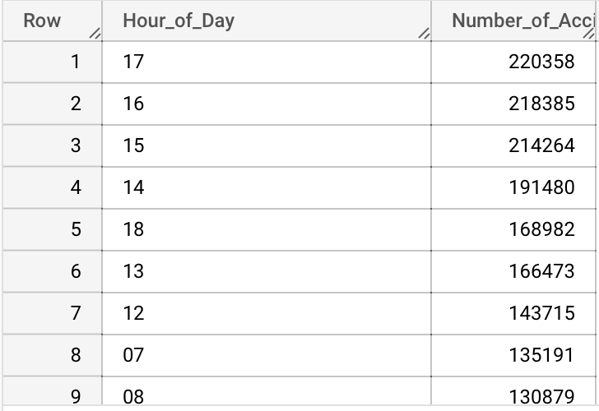
Query: Number of Accidents by Hour of the Day

Slide 22
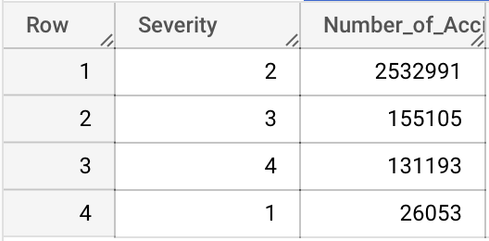
Query: Number of Accidents Based on Severity

Slide 23
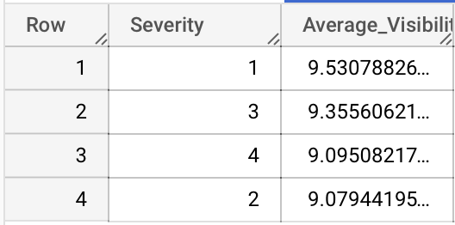
Query: Average Visibility Based on Severity

Slide 24
Moving Forward
ETL scripts can be implemented to continuously extract, transform and load the data to the data warehouse and used for analytics in real time
Machine Learning can be implemented to extract even more meaningful trends which help create predictive models on where and when accidents will occur
These predictive models can also be used by the NHTSA to proactively look out and implement better safety precautions before the accident even happens.

Slide 25


